Slide 1
Chapter 13: I/O Systems

Slide 2
Chapter 13: I/O Systems
I/O Hardware
Application I/O Interface
Kernel I/O Subsystem
Transforming I/O Requests to Hardware Operations
STREAMS
Performance

Slide 3
Objectives
Explore the structure of an operating system’s I/O subsystem
Discuss the principles of I/O hardware and its complexity
Provide details of the performance aspects of I/O hardware and software

Slide 4
Overview
I/O management is a major component of operating system design and operation
Important aspect of computer operation
I/O devices vary greatly
Various methods to control them
Performance management
New types of devices frequent
Ports, busses, device controllers connect to various devices
Device drivers encapsulate device details
Present uniform device-access interface to I/O subsystem

Slide 5
I/O Hardware
Incredible variety of I/O devices
Storage
Transmission
Human-interface
Common concepts – signals from I/O devices interface with computer
Port(端口) – connection point for device
Bus(总线) - daisy chain or shared direct access
Controller (host adapter)(控制器) – electronics that operate port, bus, device
Sometimes integrated
Sometimes separate circuit board (host adapter)
Contains processor, microcode, private memory, bus controller, etc
Some talk to per-device controller with bus controller, microcode, memory, etc

Slide 6
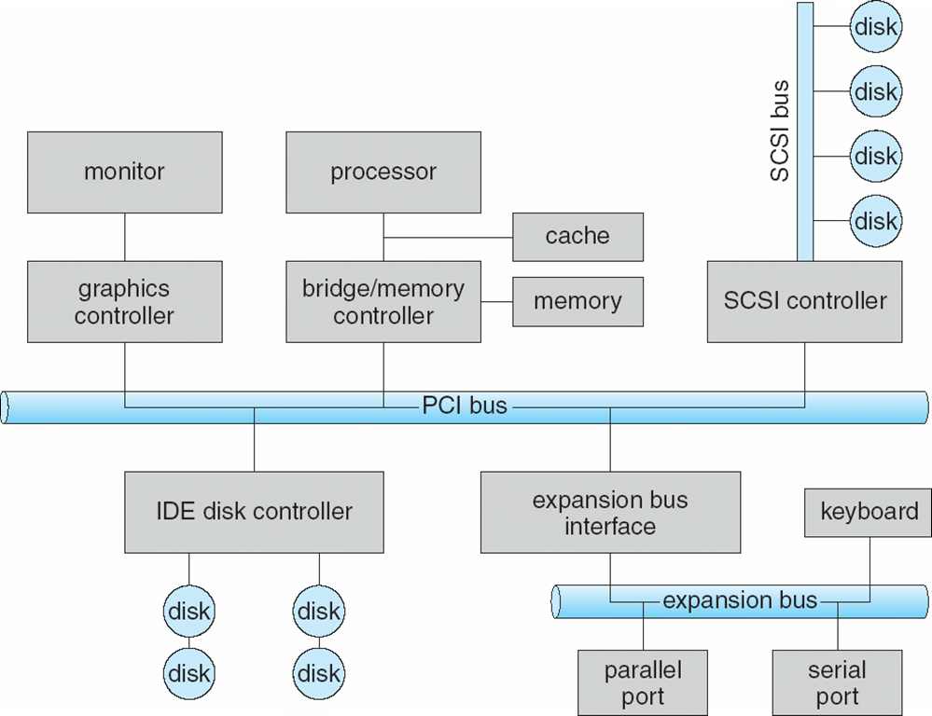
A Typical PC Bus Structure

Slide 7
I/O Hardware (Cont.)
I/O instructions control devices
Devices usually have registers where device driver places commands, addresses, and data to write, or read data from registers after command execution
Data-in register, data-out register, status register, control register
Typically 1-4 bytes, or FIFO buffer
Devices have addresses, used by
Direct I/O instructions
Memory-mapped I/O
Device data and command registers mapped to processor address space
Especially for large address spaces (graphics)

Slide 8
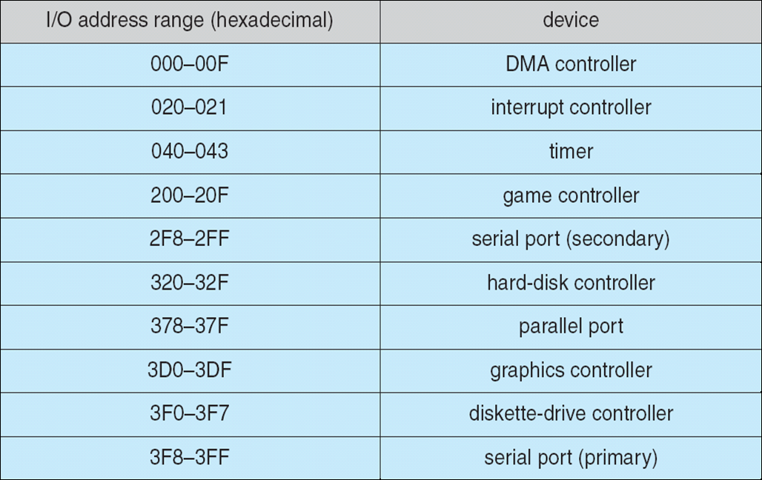
Device I/O Port Locations on PCs (partial)

Slide 9
Polling
For each byte of I/O
Read busy bit from status register until 0
Host sets read or write bit and if write copies data into data-out register
Host sets command-ready bit
Controller sets busy bit, executes transfer
Controller clears busy bit, error bit, command-ready bit when transfer done
Step 1 is busy-wait cycle to wait for I/O from device
Reasonable if device is fast
But inefficient if device slow
CPU switches to other tasks?
But if miss a cycle data overwritten / lost

Slide 10
Interrupts
Polling can happen in 3 instruction cycles
Read status, logical-and to extract status bit, branch if not zero
How to be more efficient if non-zero infrequently?
CPU Interrupt-request line triggered by I/O device
Checked by processor after each instruction
Interrupt handler receives interrupts
Maskable(可屏蔽的) to ignore or delay some interrupts
Interrupt vector to dispatch interrupt to correct handler
Context switch at start and end
Based on priority
Some nonmaskable
Interrupt chaining if more than one device at same interrupt number

Slide 11
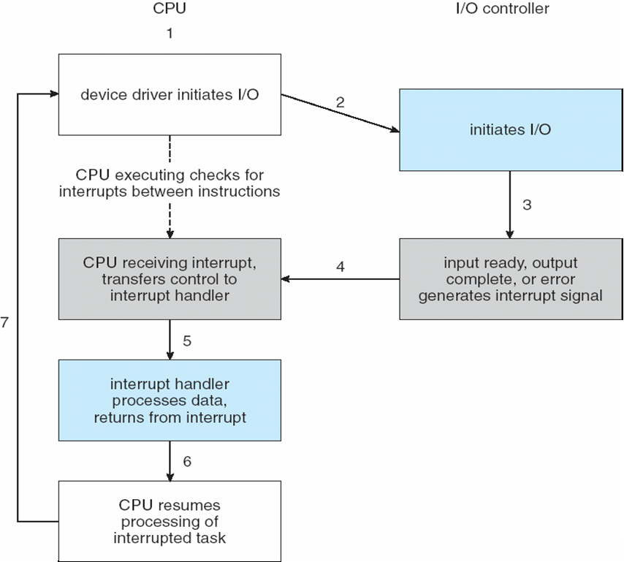
Interrupt-Driven I/O Cycle

Slide 12
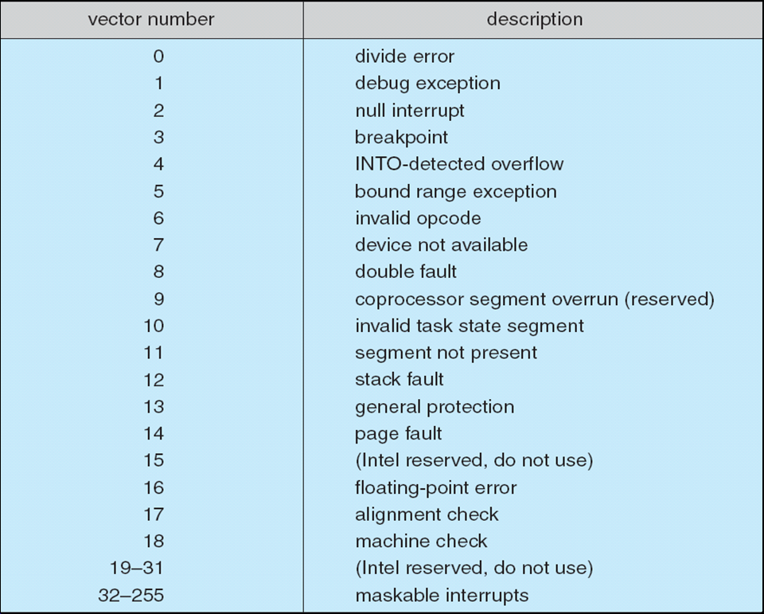
Intel Pentium Processor Event-Vector Table

Slide 13
Interrupts (Cont.)
Interrupt mechanism also used for exceptions
Terminate process, crash system due to hardware error
Page fault executes when memory access error
System call executes via trap to trigger kernel to execute request
Multi-CPU systems can process interrupts concurrently
If operating system designed to handle it
Used for time-sensitive processing, frequent, must be fast

Slide 14
Direct Memory Access
Used to avoid programmed I/O (one byte at a time) for large data movement
Requires DMA controller
Bypasses CPU to transfer data directly between I/O device and memory
OS writes DMA command block into memory
Source and destination addresses
Read or write mode
Count of bytes
Writes location of command block to DMA controller
Bus mastering of DMA controller – grabs bus from CPU
When done, interrupts to signal completion

Slide 15
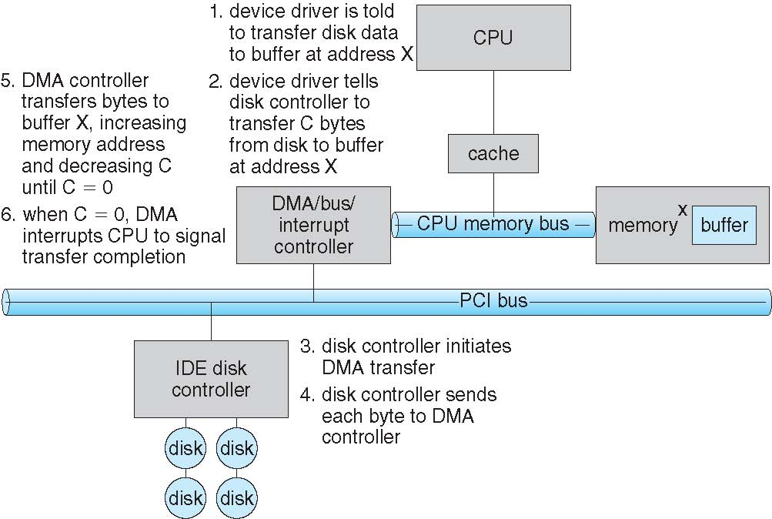
Six Step Process to Perform DMA Transfer

Slide 16
Application I/O Interface
I/O system calls encapsulate device behaviors in generic classes
Device-driver layer hides differences among I/O controllers from kernel
New devices talking already-implemented protocols need no extra work
Each OS has its own I/O subsystem structures and device driver frameworks
Devices vary in many dimensions
Character-stream or block
Sequential or random-access
Synchronous or asynchronous (or both)
Sharable or dedicated
Speed of operation
read-write, read only, or write only

Slide 17
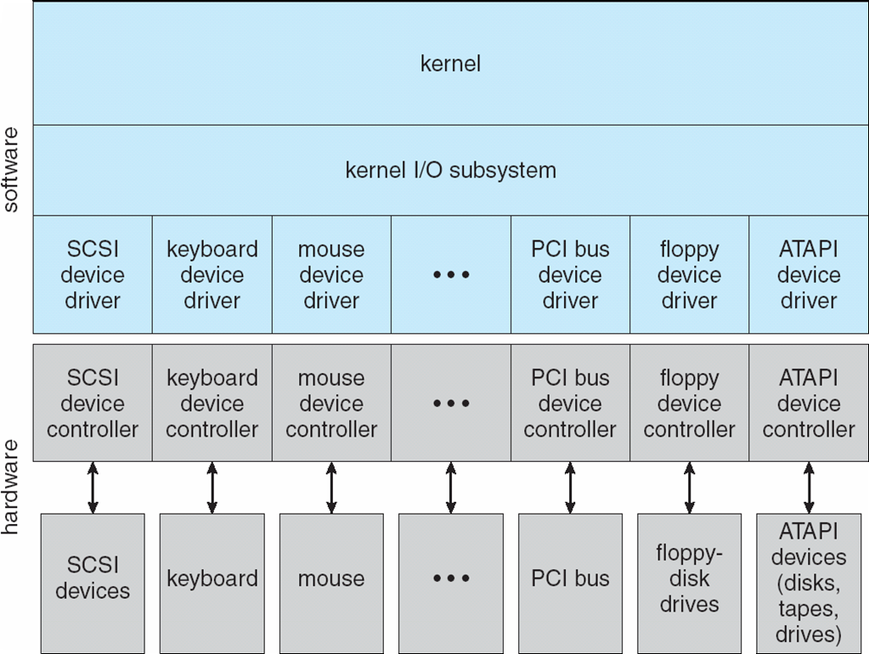
A Kernel I/O Structure

Slide 18
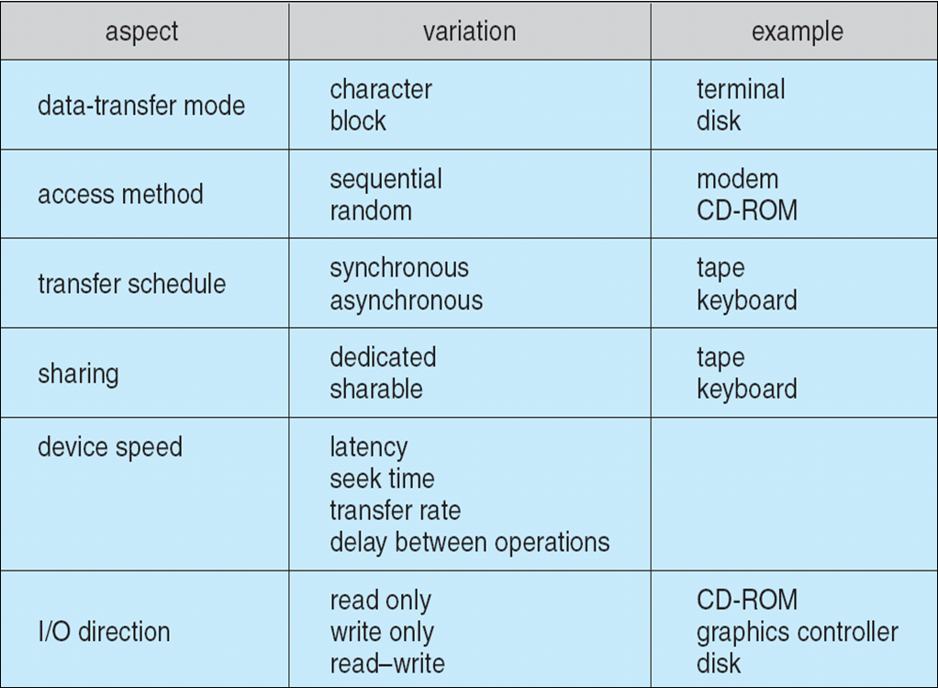
Characteristics of I/O Devices

Slide 19
Characteristics of I/O Devices (Cont.)
Subtleties of devices handled by device drivers
Broadly I/O devices can be grouped by the OS into
Block I/O
Character I/O (Stream)
Memory-mapped file access
Network sockets
For direct manipulation of I/O device specific characteristics, usually an escape / back door
Unix ioctl() call to send arbitrary bits to a device control register and data to device data register

Slide 20
Block and Character Devices
Block devices include disk drives
Commands include read, write, seek
Raw I/O, direct I/O, or file-system access
Memory-mapped file access possible
File mapped to virtual memory and clusters brought via demand paging
DMA
Character devices include keyboards, mice, serial ports
Commands include get(), put()
Libraries layered on top allow line editing

Slide 21
Network Devices
Varying enough from block and character to have own interface
Unix and Windows NT/9x/2000 include socket interface
Separates network protocol from network operation
Includes select() functionality
Approaches vary widely (pipes, FIFOs, streams, queues, mailboxes)

Slide 22
Clocks and Timers
Provide current time, elapsed time, timer
Normal resolution about 1/60 second
Some systems provide higher-resolution timers
Programmable interval timer used for timings, periodic interrupts
ioctl() (on UNIX) covers odd aspects of I/O such as clocks and timers

Slide 23
Blocking and Nonblocking I/O
Blocking - process suspended until I/O completed
Easy to use and understand
Insufficient for some needs
Nonblocking - I/O call returns as much as available
User interface, data copy (buffered I/O)
Implemented via multi-threading
Returns quickly with count of bytes read or written
select() to find if data ready then read() or write() to transfer
Asynchronous - process runs while I/O executes
Difficult to use
I/O subsystem signals process when I/O completed

Slide 24
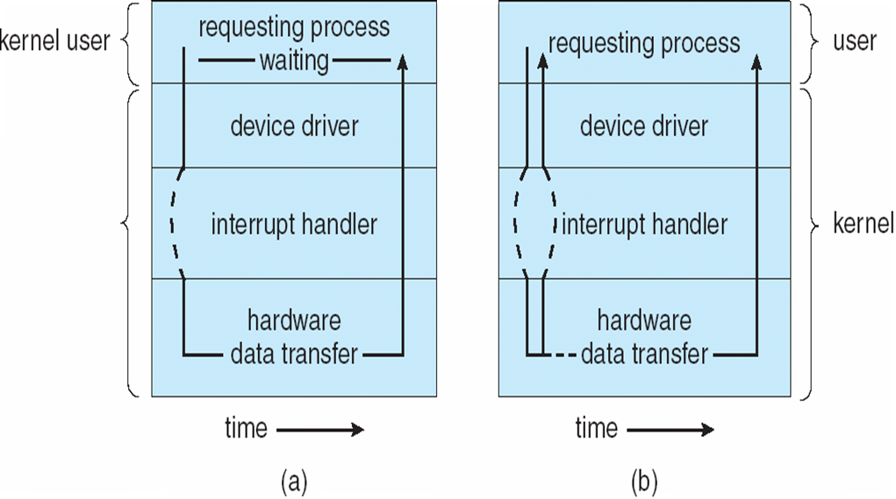
Two I/O Methods
Synchronous
Asynchronous

Slide 25
Kernel I/O Subsystem
Scheduling
Some I/O request ordering via per-device queue
Some OSs try fairness
Some implement Quality Of Service (i.e. IPQOS)
Buffering - store data in memory while transferring between devices
To cope with device speed mismatch
To cope with device transfer size mismatch
To maintain “copy semantics”
Double buffering – two copies of the data
Kernel and user
Varying sizes
Full / being processed and not-full / being used
Copy-on-write can be used for efficiency in some cases

Slide 26
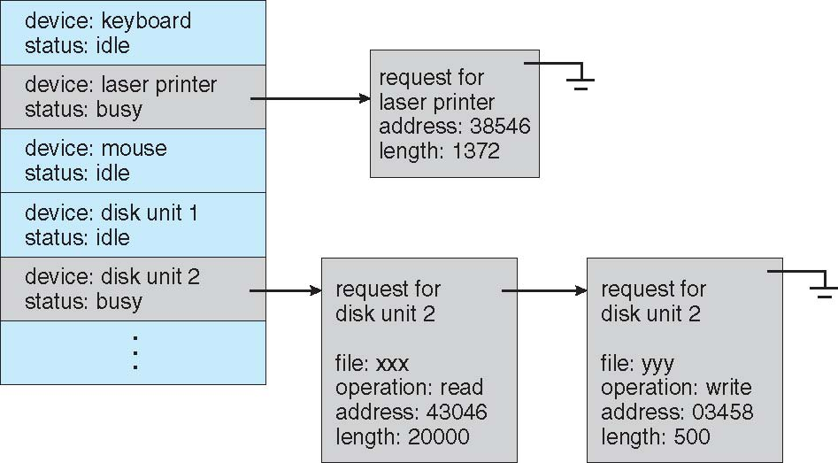
Device-status Table

Slide 27
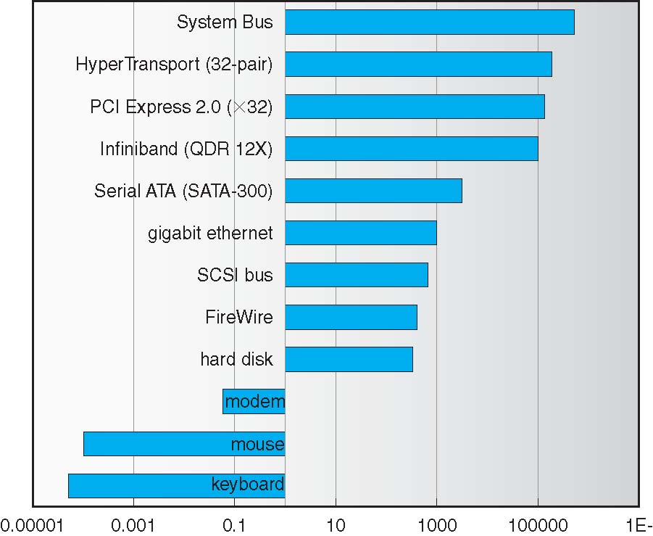
Sun Enterprise 6000 Device-Transfer Rates

Slide 28
Kernel I/O Subsystem
Caching - faster device holding copy of data
Always just a copy
Key to performance
Sometimes combined with buffering
Spooling - hold output for a device
If device can serve only one request at a time
i.e., Printing
Device reservation - provides exclusive access to a device
System calls for allocation and de-allocation
Watch out for deadlock

Slide 29
Error Handling
OS can recover from disk read, device unavailable, transient write failures
Retry a read or write, for example
Some systems more advanced – Solaris FMA, AIX
Track error frequencies, stop using device with increasing frequency of retry-able errors
Most return an error number or code when I/O request fails
System error logs hold problem reports

Slide 30
I/O Protection
User process may accidentally or purposefully attempt to disrupt normal operation via illegal I/O instructions
All I/O instructions defined to be privileged
I/O must be performed via system calls
Memory-mapped and I/O port memory locations must be protected too

Slide 31
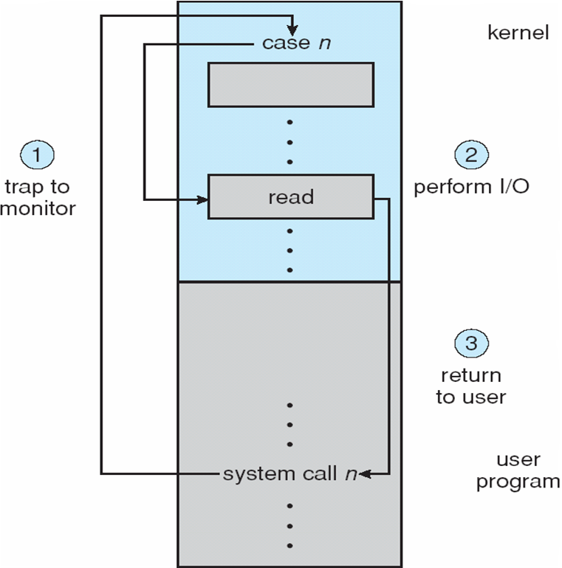
Use of a System Call to Perform I/O

Slide 32
Kernel Data Structures
Kernel keeps state info for I/O components, including open file tables, network connections, character device state
Many, many complex data structures to track buffers, memory allocation, “dirty” blocks
Some use object-oriented methods and message passing to implement I/O
Windows uses message passing
Message with I/O information passed from user mode into kernel
Message modified as it flows through to device driver and back to process
Pros / cons?

Slide 33
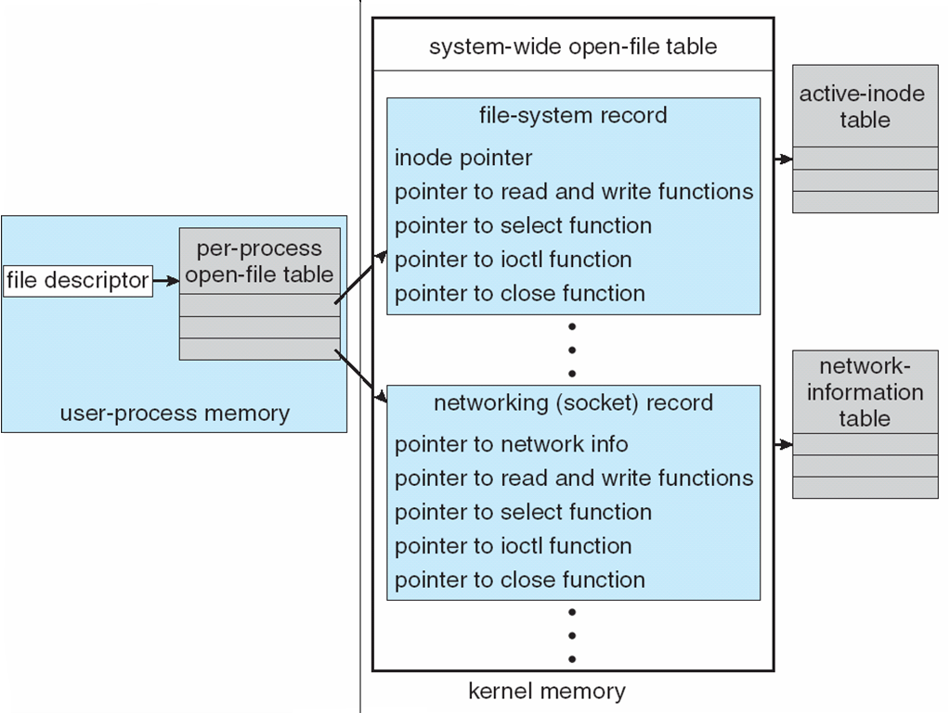
UNIX I/O Kernel Structure

Slide 34
I/O Requests to Hardware Operations
Consider reading a file from disk for a process:
Determine device holding file
Translate name to device representation
Physically read data from disk into buffer
Make data available to requesting process
Return control to process

Slide 35
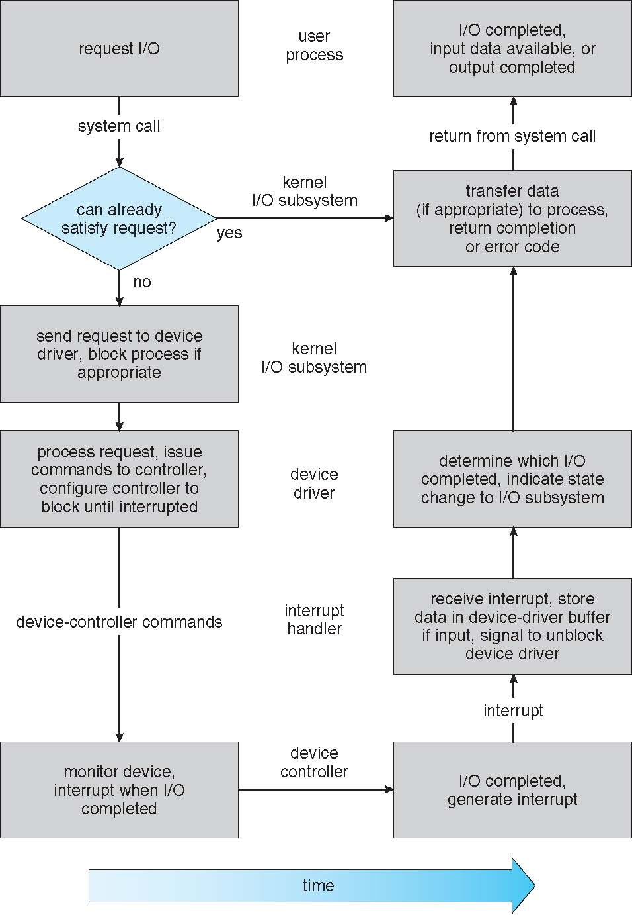
Life Cycle of An I/O Request

Slide 36
STREAMS
STREAM – a full-duplex communication channel between a user-level process and a device in Unix System V and beyond
A STREAM consists of:
- STREAM head interfaces with the user process
- driver end interfaces with the device - zero or more STREAM modules between them
Each module contains a read queue and a write queue
Message passing is used to communicate between queues
Flow control option to indicate available or busy
Asynchronous internally, synchronous where user process communicates with stream head

Slide 37
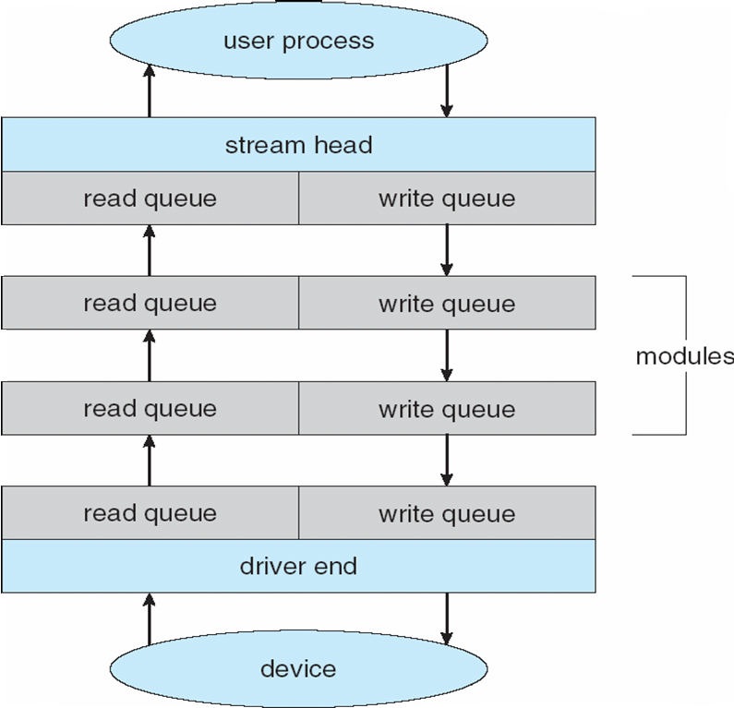
The STREAMS Structure

Slide 38
Performance
I/O a major factor in system performance:
Demands CPU to execute device driver, kernel I/O code
Context switches due to interrupts
Data copying
Network traffic especially stressful

Slide 39
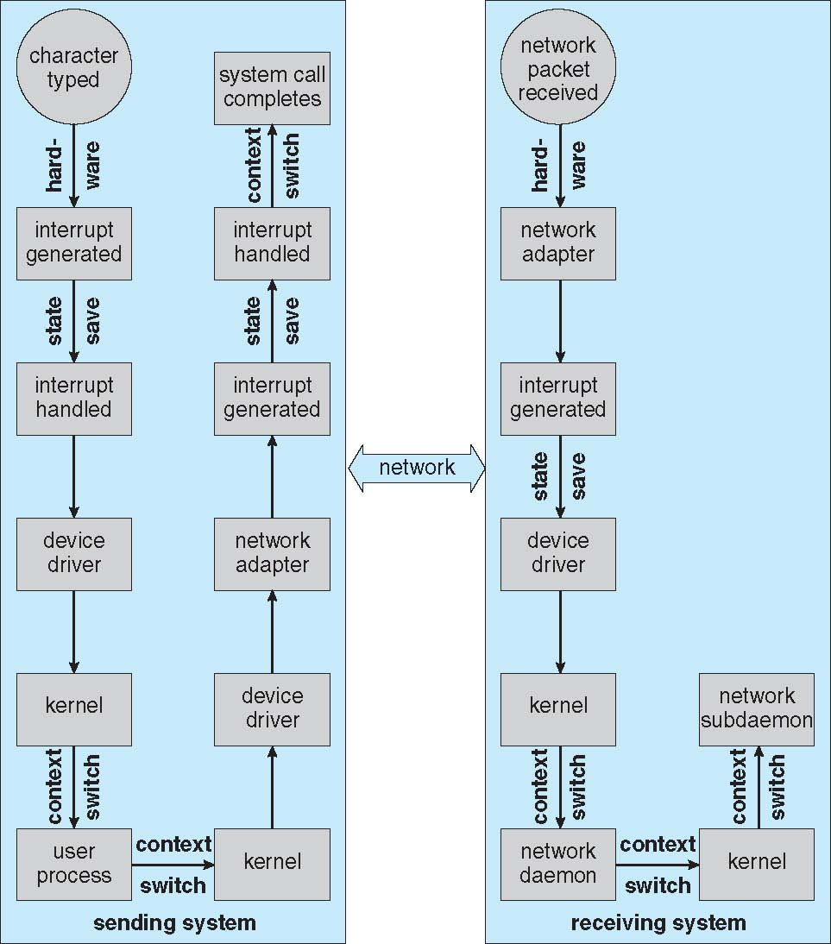
Intercomputer Communications

Slide 40
Improving Performance
Reduce number of context switches
Reduce data copying
Reduce interrupts by using large transfers, smart controllers, polling
Use DMA
Use smarter hardware devices
Balance CPU, memory, bus, and I/O performance for highest throughput
Move user-mode processes / daemons to kernel threads

Slide 41
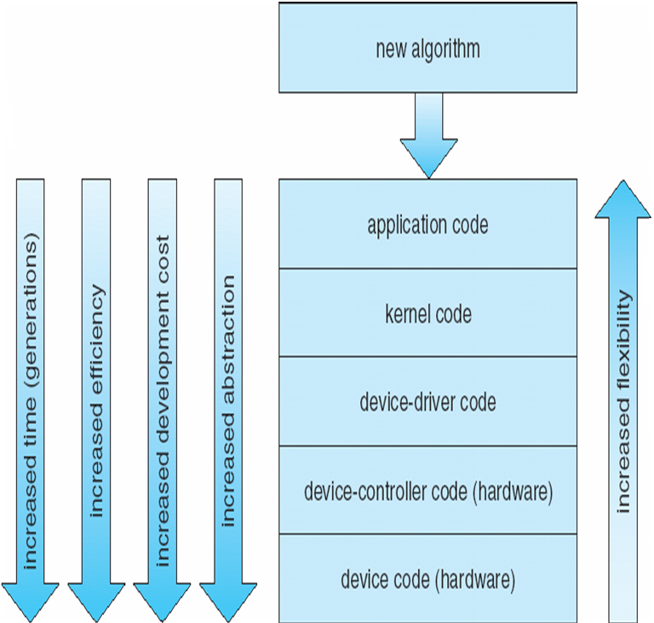
Device-Functionality Progression

Slide 42
End of Chapter 12

